Slide 1

If Not Notebooks, Then What?
Thoughts on notebooks and reproducibility
AAAI 2019 Workshop on Reproducible AI
Joel Grus
@joelgrus
Notes:
I'm Joel, and I work at the Allen Institute for Artificial Intelligence, and I'm going to talk about notebooks and reproducibility

Slide 2
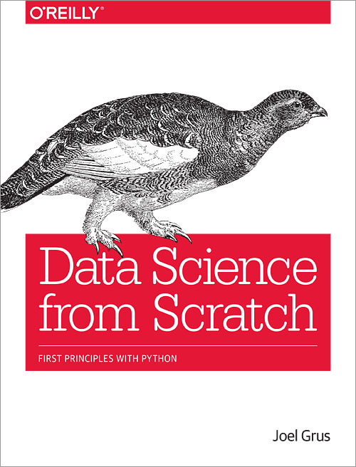
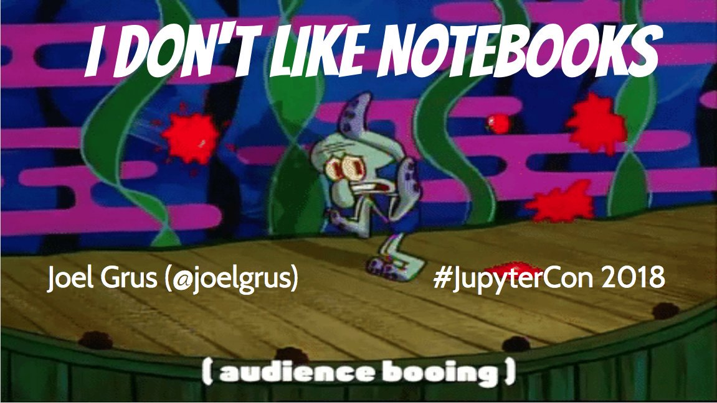

About Me
Research engineer on the AllenNLP team
Previously SWE@Google, Data Science@VoloMetrix, …
Author of Data Science from Scratch
Co-host of "Adversarial Learning" podcast
The "Fizz Buzz in Tensorflow" guy
Started "the first notebook war"
Notes:
so who am I?

Slide 3
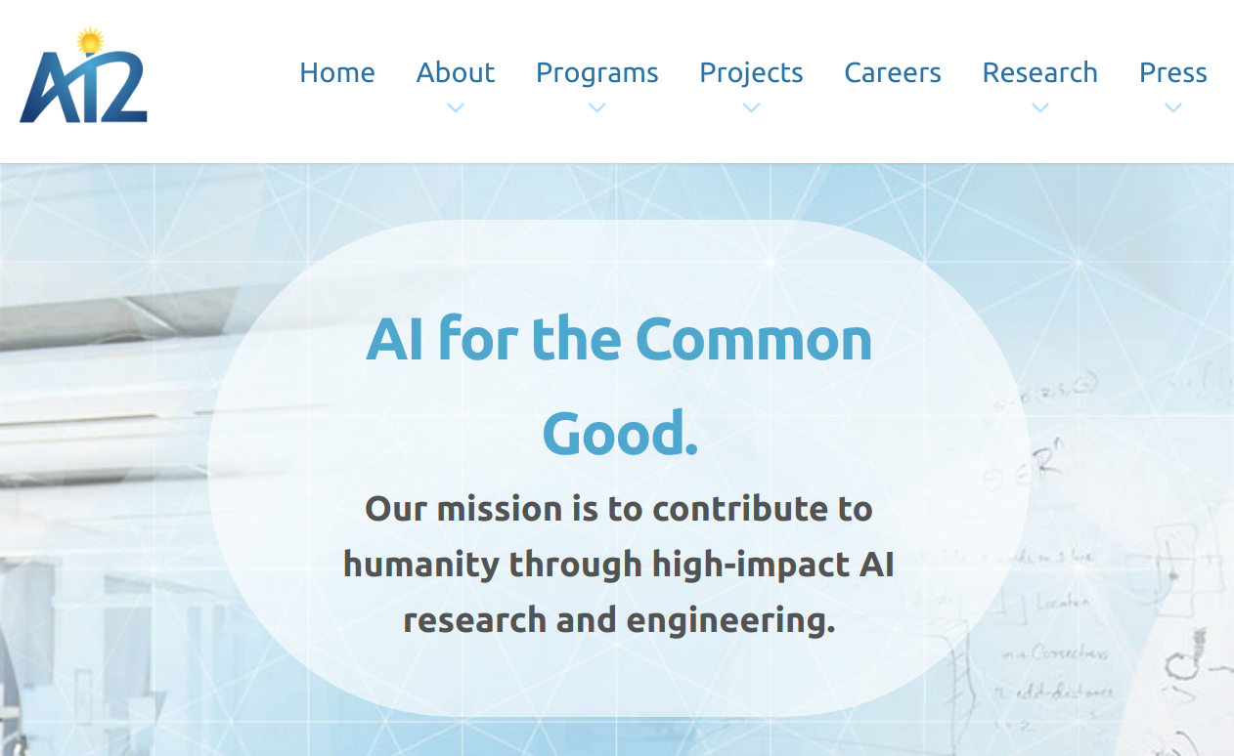
Notes:
AI2 is a research nonprofit, we work on fundamental problems in natural language understanding, computer vision, common-sense reasoning, and things like that

Slide 4
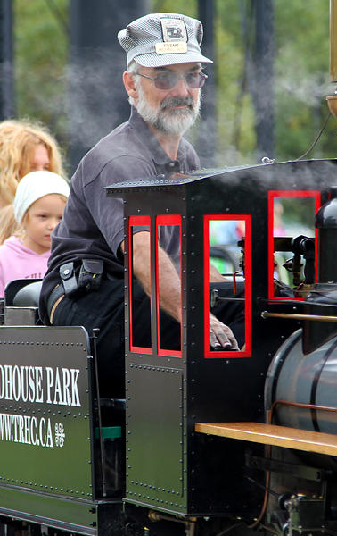
What is a Research Engineer?
I'm not a researcher
(although I can pretend to be one)
I'm an engineer who cares deeply about research
My job is to help researchers be successful
by building tools for them
by advocating best practices
and also by collaborating with them
And so my job involves thinking a lot about reproducibility
Notes:
so, I'm a research engineer, what does that mean ?

Slide 5
Outline
Why reproducibility?
Why not notebooks?
If not notebooks, then what?
Reproducibility and AllenNLP
Reproducibility and Beaker
Notes:
so what am I going to talk about?

Slide 6
Why Reproducibility?
Notes:
ok, so why do we care about reproducibility?
I can't speak for you, so instead I'll tell you why *I* care about reproducibility

Slide 7

I take a somewhat expansive view of the role of reproducibility in science
Notes:
and I'll warn you that I have a somewhat expansive view of why reproducibility matters
https://drscdn.500px.org/photo/46424674/m%3D900/v2?webp=true&sig=9ecf11e12998e01f29a4efec1aa3ee0106c758c29def5898ec42cc9ddb1eeff7

Slide 8

Reproducibility Helps With Correctness
If no one ever runs your code but you, it might be wrong
Notes:
the most obvious reason is that we want to reproduce results to make sure they're correct
alternatively, if no one can get the same results as you, it's likely you did something wrong

Slide 9
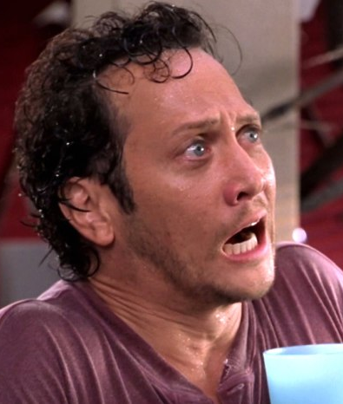
Reproducibility Protects Against Bad Actors
Certainly you would never try to publish fraudulent research, but what about your bitter rival?
(Hopefully this is a minor consideration.)
Notes:
we know that none of you would ever try to make up results and publish them, but what about that guy you knew in grad school.
hopefully this is a minor consideration

Slide 10
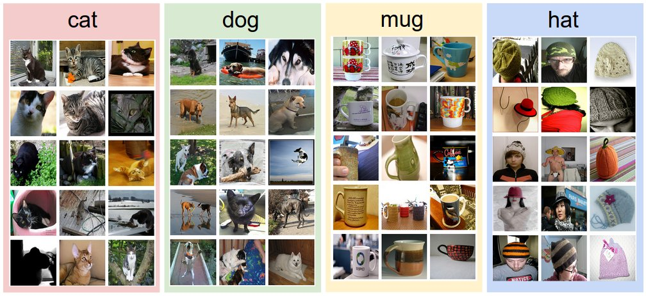
Reproducibility Makes It Easy to Try New Datasets
Maybe your model works great on a different dataset
Maybe it works terribly on a different dataset
Hard datasets help move AI forward
Notes:
you tried your model on your favorite dataset, but everyone wants to know how it works on this new, harder dataset. that means they need to be able to run it.

Slide 11
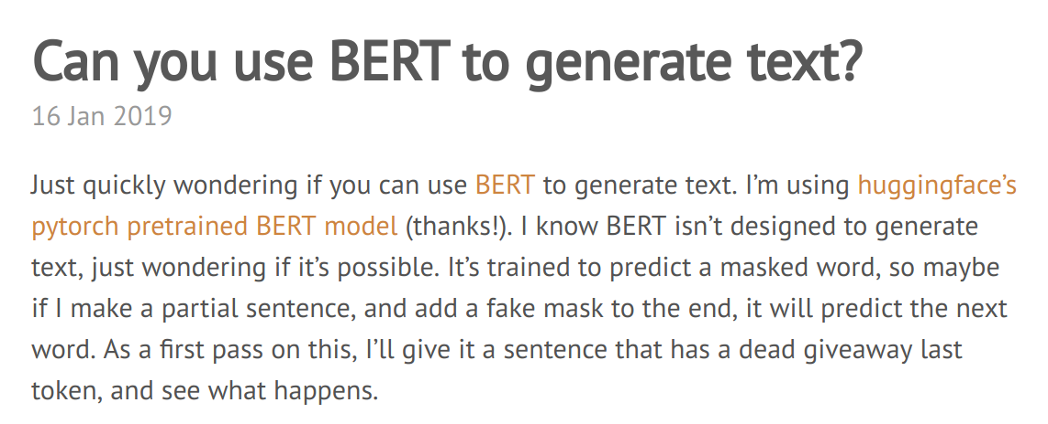
Reproducibility Makes It Easy to Try New Tasks
You haven't thought of (or tried) every way your model could be used
Notes:
similarly, I have an idea as to how your model could be applied to my different task. this requires me to be able to run your model.
http://mayhewsw.github.io/2019/01/16/can-bert-generate-text/

Slide 12

Reproducibility Enables Strong Baselines
Wouldn't you like your model to be the standard by which new models are judged?
Notes:
if your model is really good, people are going to want to use it as a baseline. but they can't do that if they can't run it

Slide 13

Reproducibility Is Necessary For Extensibility
"you can't stand on the shoulders of giants if they keep their shoulders private"
Notes:
and the way science proceeds is that people take what you do and build on it

Slide 14
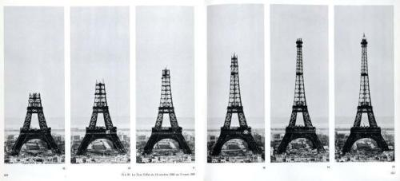
Extensibility Leads to Progress
Notes:
but you can't build on it if you can't reproduce it

Slide 15
Extensibility Leads to Progress
?
BERT
transformer
attention
Notes:
to give one example,

Slide 16
Fundamental Premise:
The tools you choose and the processes you adopt can make reproducibility either a lot harder or a lot easier.

Slide 17

Why Not Notebooks?
Notes:
ok, so now I've told you how I feel about extensibility, now I'm going to tell you about notebooks
and in particular, i'm going to talk about jupyter notebooks, because
that's the kind I know about, and
my prior is that most AI people are working in Python, so that's the most relevant kind of notebook

Slide 18
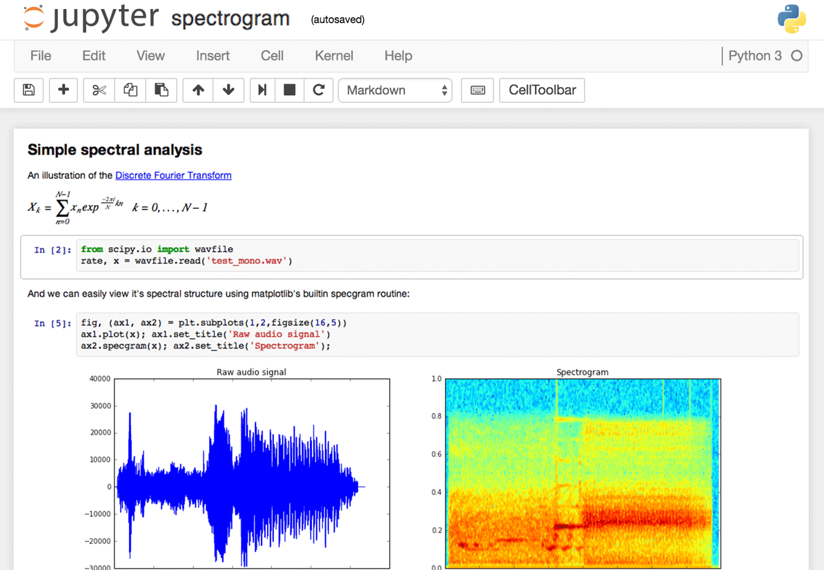
What are Jupyter Notebooks?
Computational environment that uses the lab notebook as a metaphor
Easy to mix marked-up text, executable code, results, visualizations, interactive widgets, and so on
Very popular with data scientists, less so (?) with researchers
Often promoted as beneficial for "reproducibility"
Notes:
now, you're here because you're interested in reproducibility, not necessarily because you're interested in notebooks, so it's possible you don't know what I'm talking about.

Slide 19
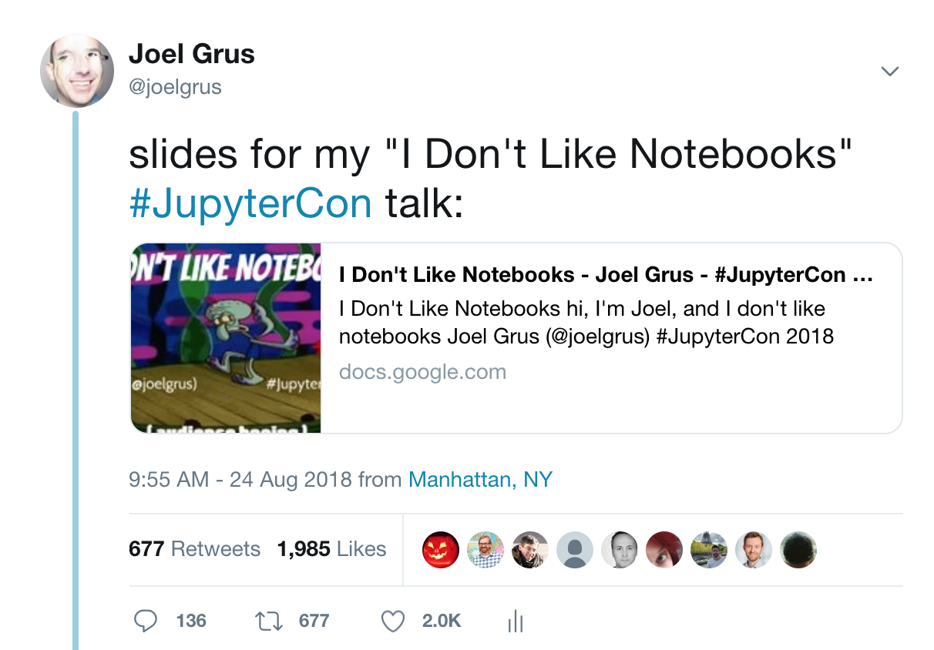
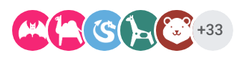
Notes:
so the reason I got invited here is because of a talk I gave at JupyterCon:
https://docs.google.com/presentation/d/1n2RlMdmv1p25Xy5thJUhkKGvjtV-dkAIsUXP-AL4ffI/edit?usp=sharing
it was 6 months ago, but still if you go to the slides there's always like 30 people looking at them. so it seems to have resonated.

Slide 20
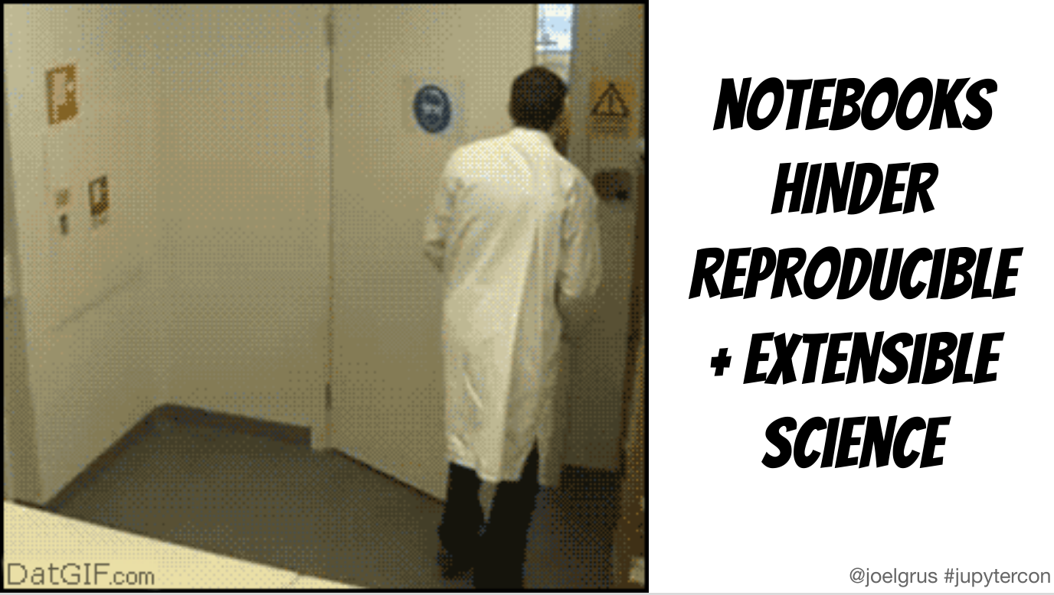

How Could Someone Not Like Notebooks?
I had a lot of complaints (but also some positives and suggestions)
It's a very comprehensive talk, you should check it out
A lot of the complaints were around user-unfriendliness + confusingness
One dislike was particularly relevant to this workshop:
Notes:
ok, so probably some of you like notebooks, and possibly you're wondering how someone could not like them?
I had a lot of complaints, you should check out the talk -- out of order execution, hard to reason about state, bad developer experience,
but one was most relevant for this workshop:
how do I mean?

Slide 21
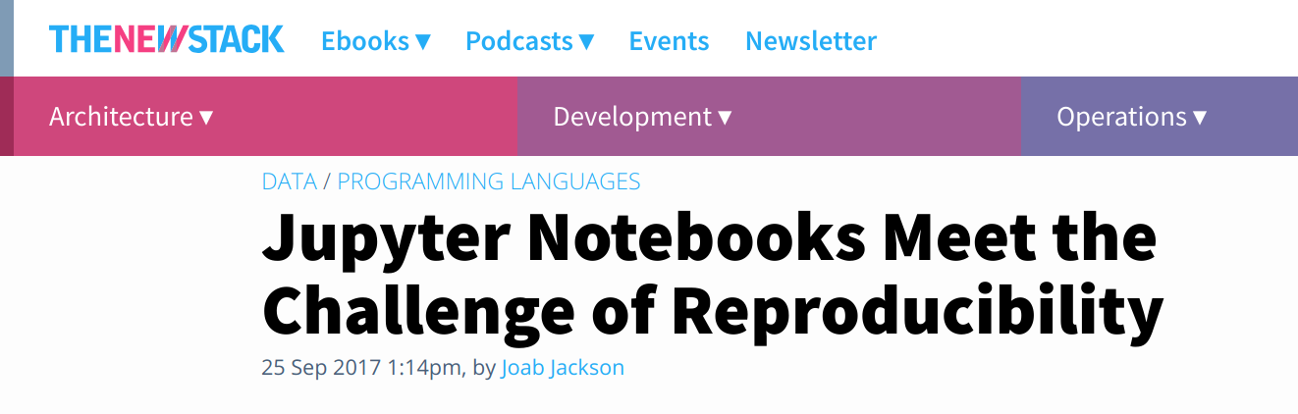
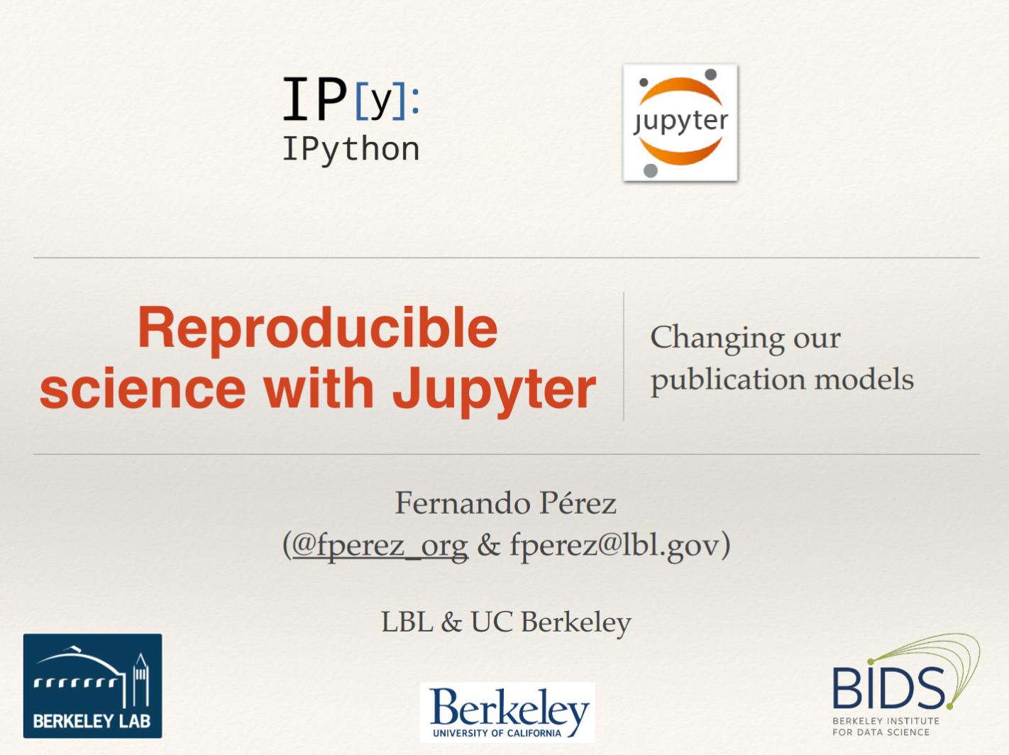
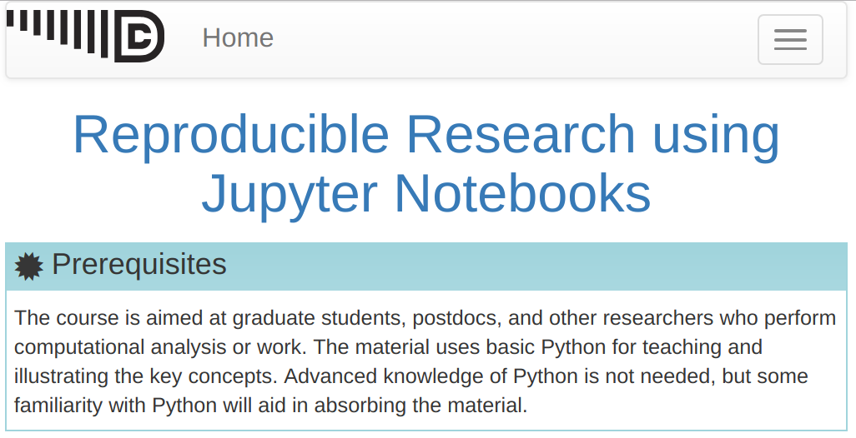
Notebooks for Reproducibility?
Notes:
and if you look around you'll find people promoting them as a solution to the reproducibility crisis

Slide 22
Code That's in Notebooks Is Hard to Re-Run
Notes:
ok, so one obvious aspect of reproducibility is that someone should be able to re-run your code

Slide 23
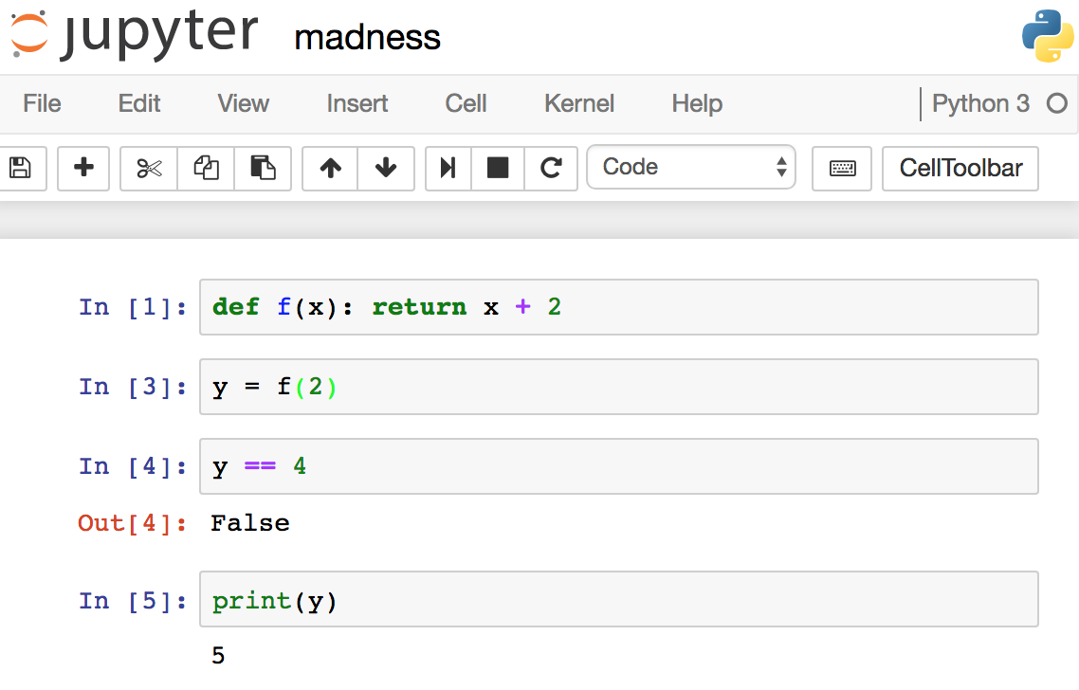
Notebooks Allow Out-of-Order Execution
unless you are very disciplined, you may not even be able to reproduce your work

Slide 24
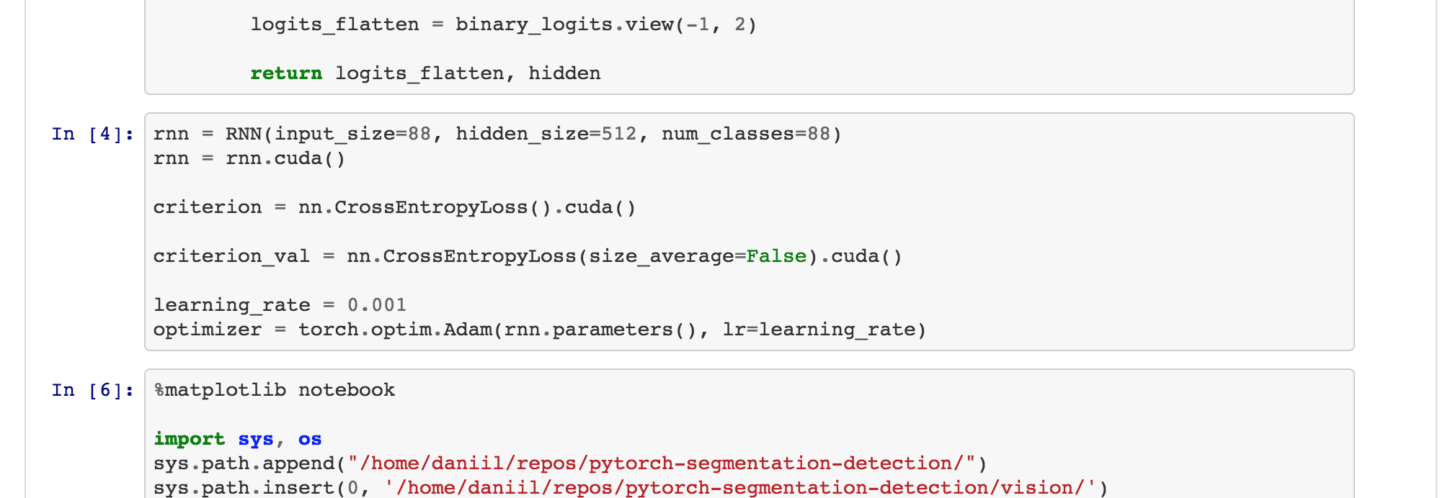
Notebooks Hard-Code Their Parameters
Notes:
this is just a random notebook I picked off the web that was training a deep learning model, but it's not atypical
it was shared on github so that you could run it
but it has paths hardcoded throughout it, parameters (number of hidden units), loss functions, and optimizers, learning rates all hardcoded in various places
if your computer (and experiment) was exactly the same, it might work, but otherwise not
to experiment with these things would be terribly difficult

Slide 25
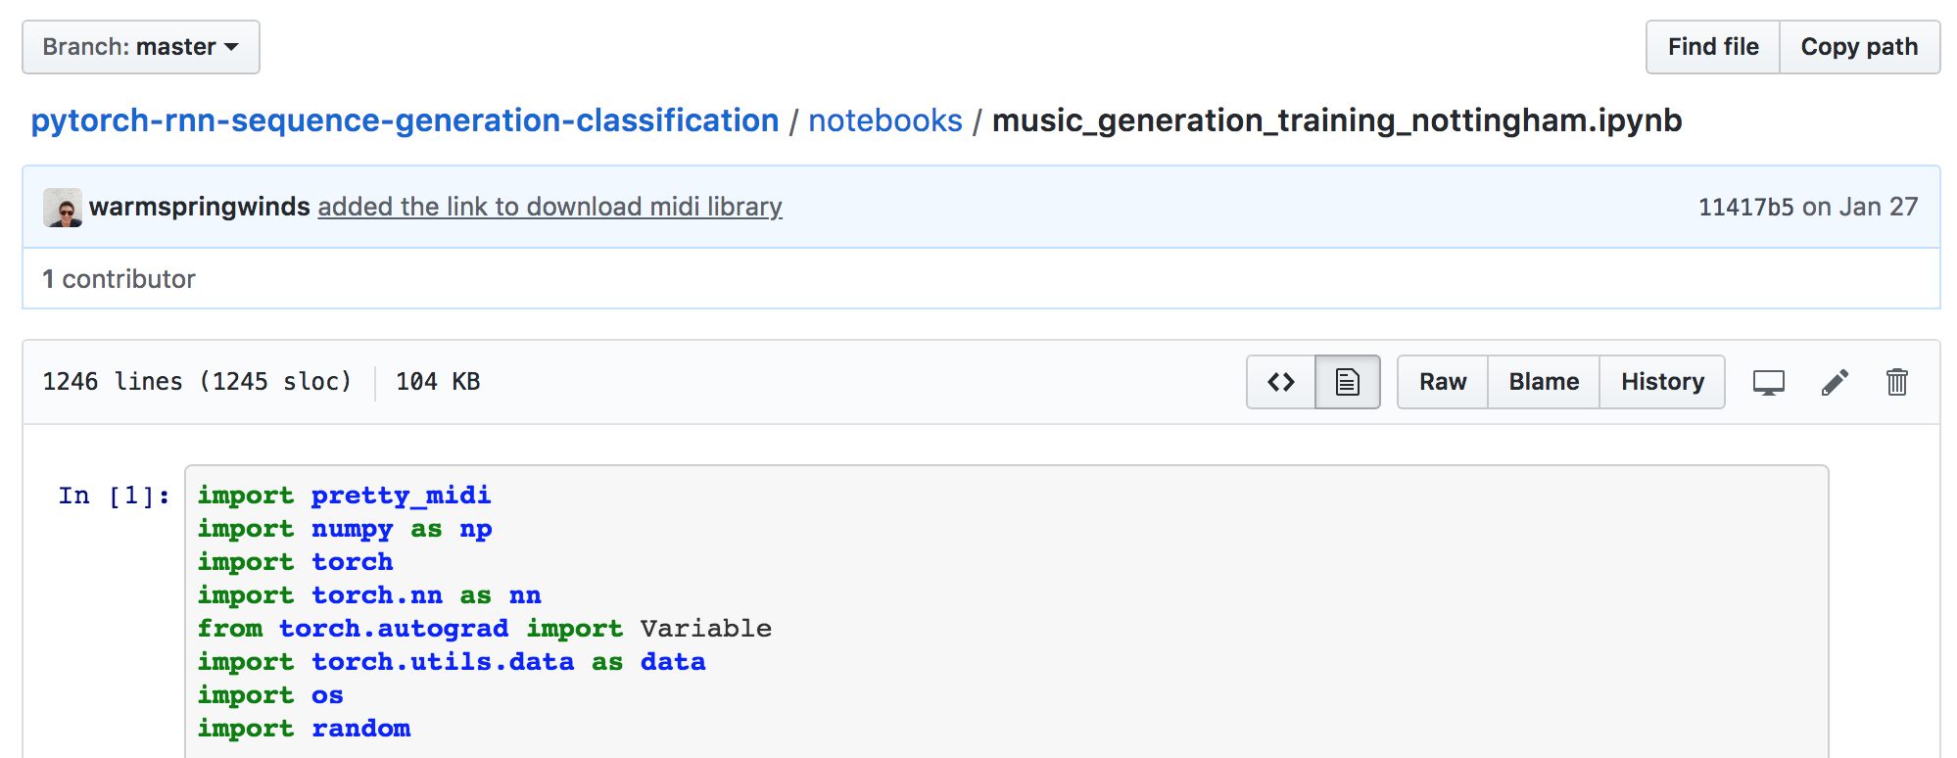
Notebooks Don't Help You Enforce Dependencies
Notes:
part of reproducibility is reproducing your environment, and a notebook doesn't do that on its own
you can specify it separately, but then suddenly you don't have a single self-contained artifact

Slide 26
Notebooks Complicate Collaboration

Slide 27

Collaboration is a Forcing Function for Reproducibility
Notes:
this is one of the things I was getting at with processes
if multiple people are running experiments, that's multiple checks that the code works as designed.
in particular, it means that it can run on more than your computer. that is itself a baby step toward reproducibility.

Slide 28
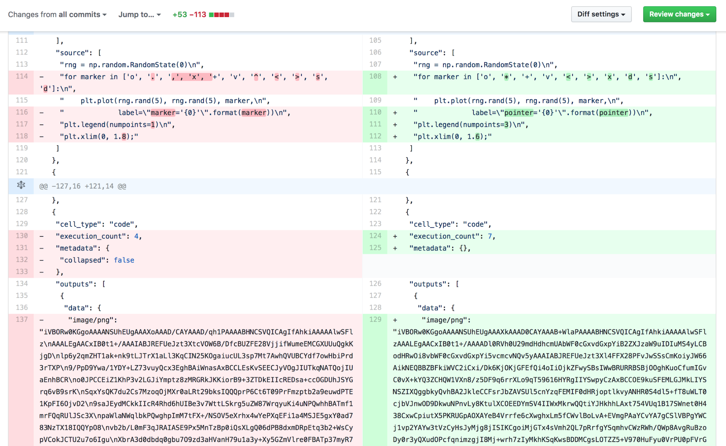
Notebooks Don't Play Well With Source Control
distributed source control is the de facto way to collaborate on coding projects
Notes:
source control is the defacto way to collaborate these days, and notebooks don't play well with it.
there are add-on tools that make it a little bit easier, but they still add a good bit of extra friction.

Slide 29
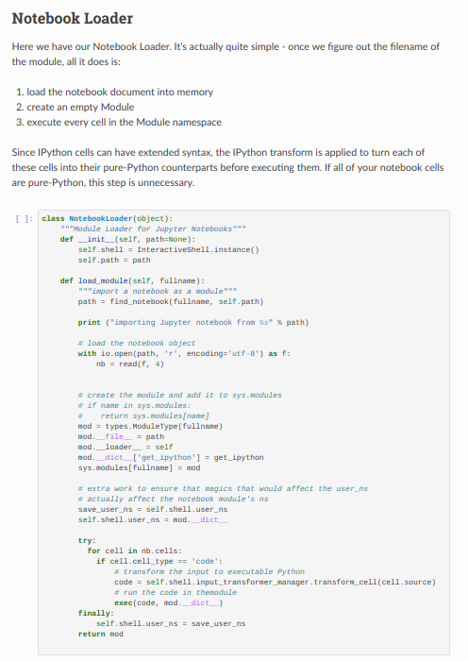
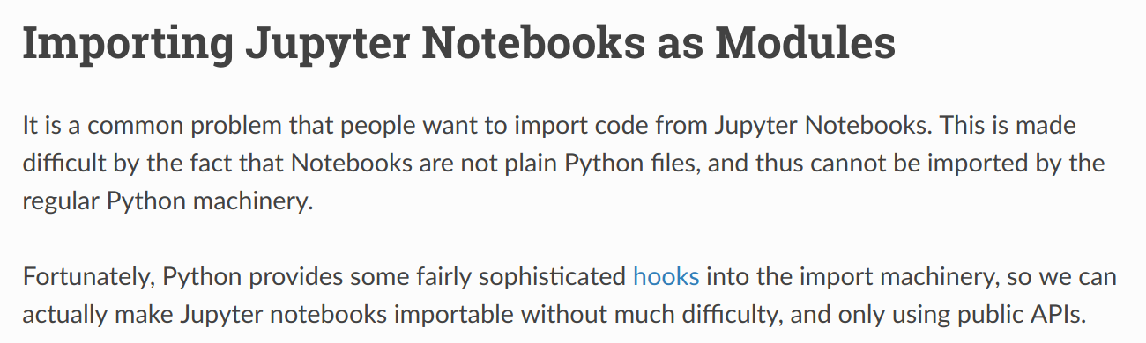
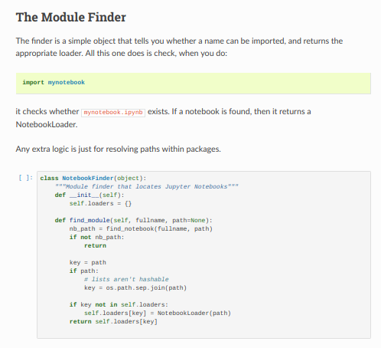
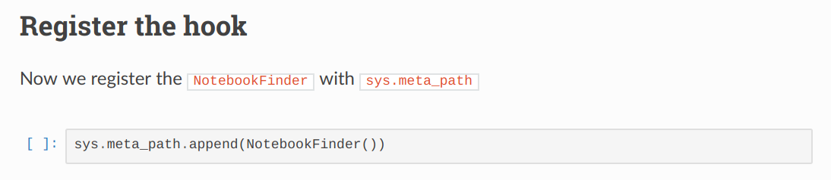
Notebooks Lock You Into
Using Notebooks
Notes:
ok, so if your code is in a notebook, someone who wants to run it is probably going to need to use notebooks themselves.
oh, there are ways to depend on notebooks in your non-notebook code, but you won't like them.

Slide 30
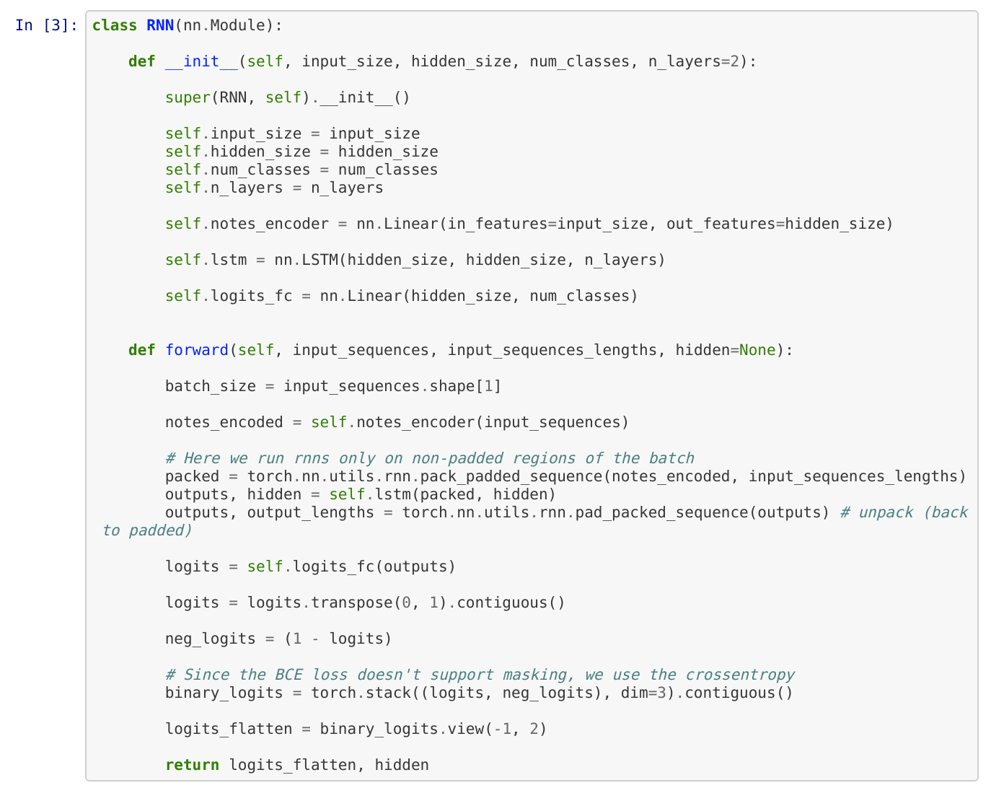
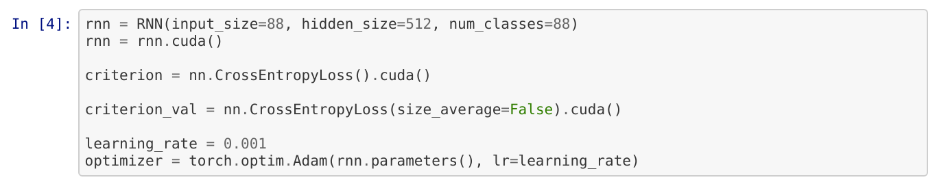
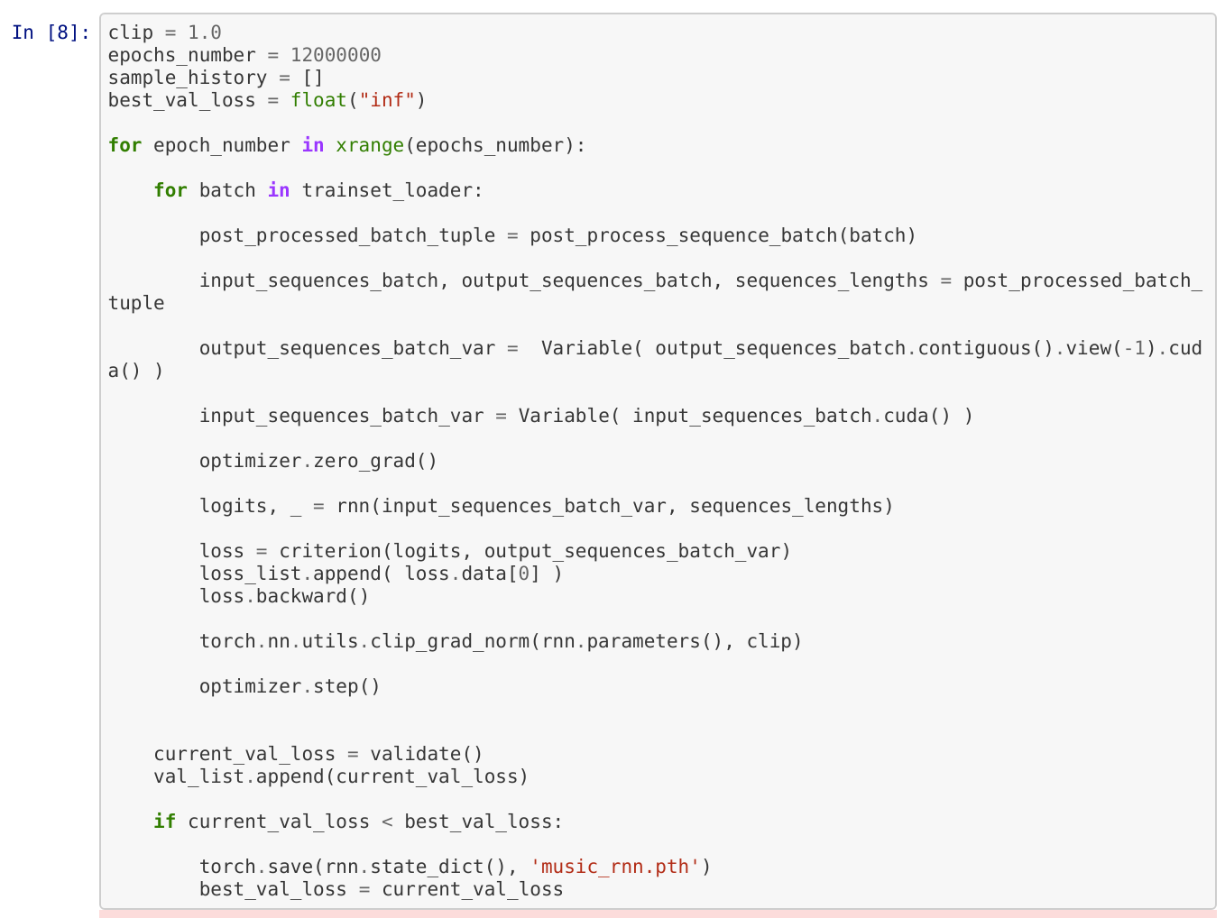
Notebooks Conflate "Library" Code and "Experiment" Code

Slide 31
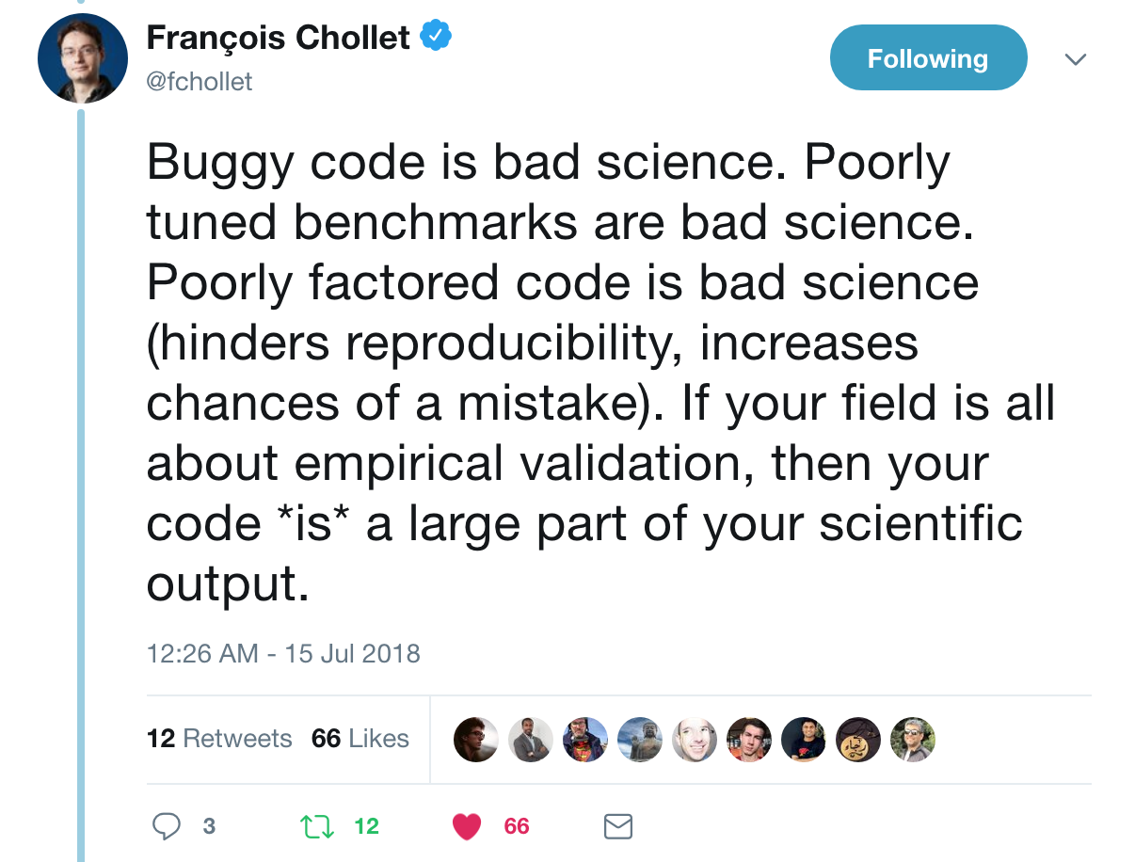
Notebooks are a recipe for poorly factored code
Notes:
I'll get into these details later, but I'll start by appealing to authority
(I don't think he agrees with me about notebooks though)

Slide 32
Notebooks Frustrate Software-Engineering Best Practices
Notes:
this is where I start harping on the "your processes make reproducibility harder or easier"

Slide 33

Software Engineering?
You may not think of your AI experiments as software engineering
But I do
And you should!
I sometimes give talks on "why data scientists should care about software engineering best practices"
This is sort of my "why AI researchers should care about software engineering best practices" variant

Slide 34
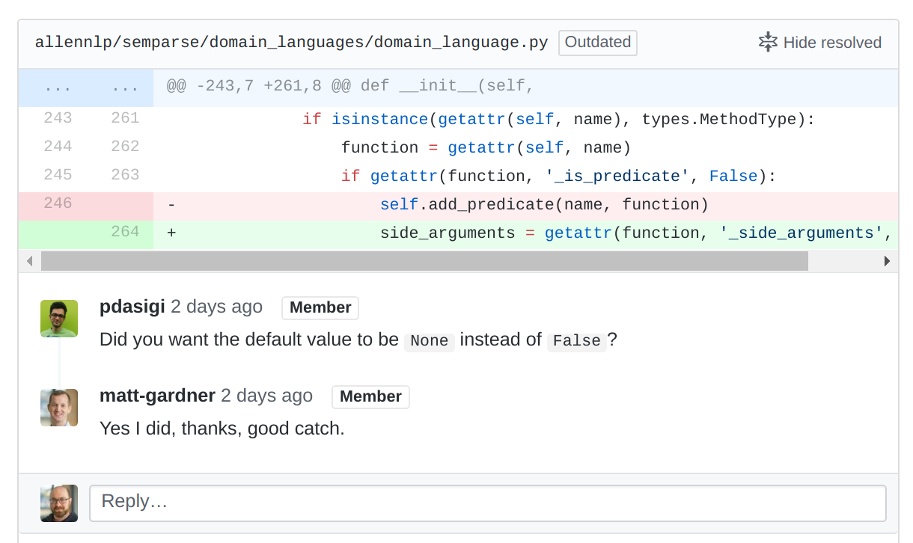
Notebooks Complicate Code Reviews
Code reviews are an early bulwark against incorrect code (and hence incorrect science)
Code reviews help you grow as a coder and as a scientist

Slide 35
Notebooks Make it Hard to Unit Test
Unit tests assure you that small pieces of your logic are correct
Unit tests make it easy to iterate by running your model end-to-end on small datasets
Unit tests make it safe to refactor your code
Unit tests are small working examples
Yes, you can put asserts in your notebook, but you want to be able to run your tests without running your experiment
ai.ipynb
# load data
# maybe assert something
# train model
# maybe assert something
# get results
# maybe assert something
# save results

Slide 36
Yeah, but what do unit tests for AI experiments even look like?

Slide 37
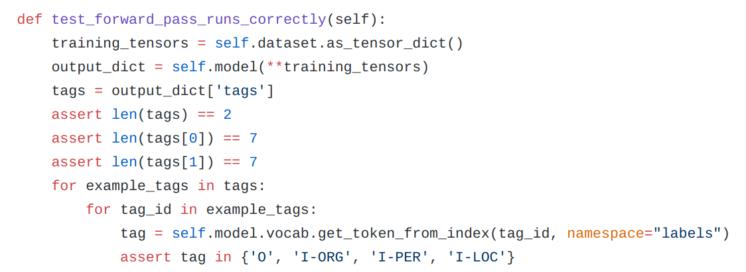
Unit Tests for AI Experiments
tiny known dataset
check that model runs
check that output has the right fields
check that output has the right shape
check that output has reasonable values
Notes:
the notebook workflow has no way to do this

Slide 38
Notebooks Make Science Harder

Slide 39
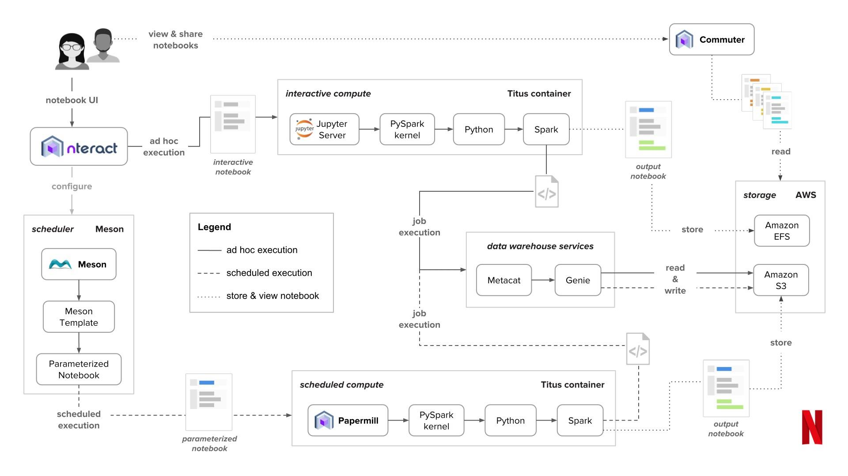
Notebooks Are Hard to Parametrize
Notes:
want to swap out datasets
want to swap out hyperparameters
want to swap out models
want to run lots of times in parallel?
look how simple this all is

Slide 40
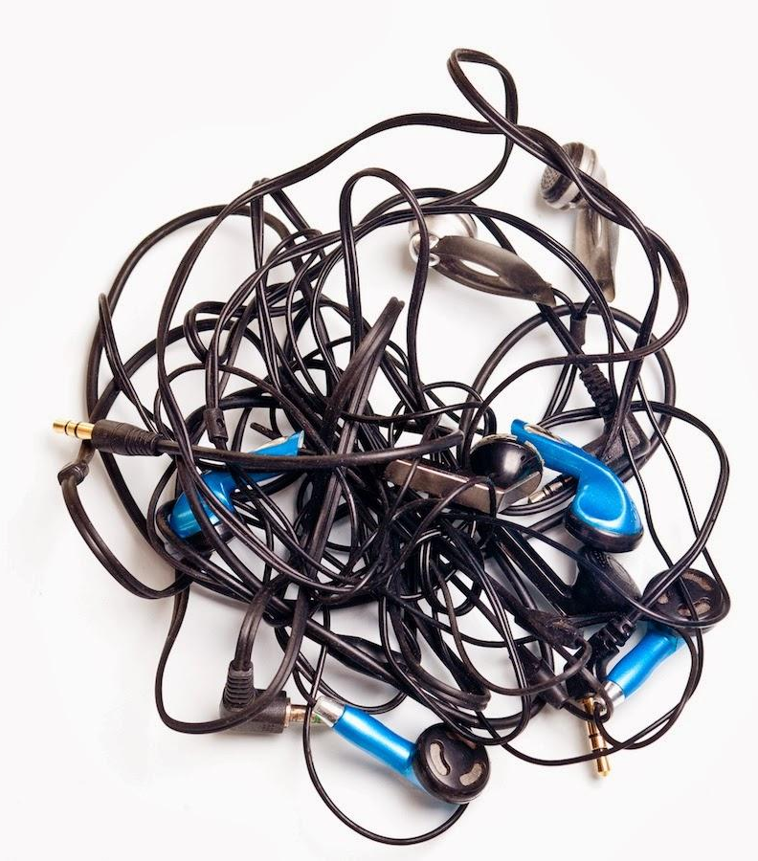
Notebooks Lump Together Code and Data
Often you'll run many experiments with the same code but different parameters
For analysis it can be good to have your results mixed in
For science you want to aggregate results across experiments
For science you want your results to have a life of their own
Notes:
that is, the most practical workflow is that a notebook represents a single experiment
but you probably want to do hundreds or thousands of experiments

Slide 41
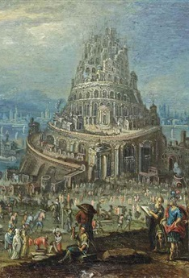
Notebook Code Can't Easily Be Built On
Notes:
if I want to build on top of your code in a notebook, I have a few options
take your notebook and modify it (forcing me to work in a notebook)
copy and paste the code out of the notebook
run nbconvert to turn the notebook into some python (that still mixes library and execution code)
do some real voodoo to import the notebook as a module

Slide 42
In Short
"Notebooks as a source of reproducibility" presupposes a static view of AI as a science:
"I did some science, now here is an artifact containing the code and data"
I'm advocating for a dynamic view:
"I did some science, now you do some more science on top of it"
Which is the kind of reproducibility that moves AI forward
Notes:
being able to build on top of things is one form of reproducibility

Slide 43
If Not Notebooks, Then What?
Notes:
ok, so it's easy for me to say "don't use notebooks"
but if I want to be convincing I should probably offer some alternatives

Slide 44
Code in Modules
# models/crf_tagger.py
class CrfTagger(Model):
"""
The ``CrfTagger`` encodes a sequence of text with a ``Seq2SeqEncoder``,
then uses a Conditional Random Field model to predict a tag for each token in the sequence.
def __init__(self, vocab: Vocabulary,
text_field_embedder: TextFieldEmbedder,
encoder: Seq2SeqEncoder,
label_namespace: str = "labels",
feedforward: Optional[FeedForward] = None,
label_encoding: Optional[str] = None,
include_start_end_transitions: bool = True,
constrain_crf_decoding: bool = None,
calculate_span_f1: bool = None,
dropout: Optional[float] = None,
verbose_metrics: bool = False,
initializer: InitializerApplicator = InitializerApplicator(),
regularizer: Optional[RegularizerApplicator] = None) -> None:
super().__init__(vocab, regularizer)
...
Notes:
putting your code in modules means you can test it
it also means you can re-use it from experiment to experiment
and it means that other people can easily use it

Slide 45

Unit Tests
develop your model on a tiny test set
iterate
run the tests frequently
Notes:
test the code that reads your data
test your model
test it all

Slide 46

The best time to find mistakes is before you run your experiments!

Slide 47
Be Explicit About Your Dependencies
#### ESSENTIAL LIBRARIES FOR MAIN FUNCTIONALITY ####
# This installs Pytorch for CUDA 8 only. If you are using a newer version,
# please visit http://pytorch.org/ and install the relevant version.
# For now AllenNLP works with both PyTorch 1.0 and 0.4.1. Expect that in
# the future only >=1.0 will be supported.
torch>=0.4.1
# Parameter parsing (but not on Windows).
jsonnet==0.10.0 ; sys.platform != 'win32'
# Adds an @overrides decorator for better documentation and error checking when using subclasses.
overrides
# Used by some old code. We moved away from it because it's too slow, but some old code still
# imports this.
nltk
# Mainly used for the faster tokenizer.
spacy>=2.0,<2.1
Notes:
anyone who wants to run your code or build on your code can just use pip to set up the correct environment

Slide 48
Make It Easy To Vary Parameters
export BERT_BASE_DIR=/path/to/bert/uncased_L-12_H-768_A-12 export GLUE_DIR=/path/to/glue python run_classifier.py \ --task_name=MRPC \ --do_train=true \ --do_eval=true \ --data_dir=$GLUE_DIR/MRPC \ --vocab_file=$BERT_BASE_DIR/vocab.txt \ --bert_config_file=$BERT_BASE_DIR/bert_config.json \ --init_checkpoint=$BERT_BASE_DIR/bert_model.ckpt \ --max_seq_length=128 \ --train_batch_size=32 \ --learning_rate=2e-5 \ --num_train_epochs=3.0 \ --output_dir=/tmp/mrpc_output/
Notes:
these are the instructions for how to run the pretrained BERT classifier
notice how explicit they are about their parameters
want to try a different learning rate? it's obvious how

Slide 49

Consider Docker Images
Create container with OS + environment + code (+ data?)
Can share and anyone can run (in theory)
Build up step by step with smart caching when you change it

Slide 50
$ docker run -it --entrypoint /bin/bash allennlp/allennlp:v0.8.0
root@7d1f120a83e9:/stage/allennlp# echo '{"sentence": "Did Uriah honestly think he could beat the game in under three hours?"}' | allennlp predict https://s3-us-west-2.amazonaws.com/allennlp/models/srl-model-2018.05.25.tar.gz -
input: {"sentence": "Did Uriah honestly think he could beat the game in under three hours?"}
prediction: {"verbs": [{"verb": "Did", "description": "[V: Did] Uriah honestly think he could beat the game in under three hours ?", "tags": ["B-V", "O", "O", "O", "O", "O", "O", "O", "O", "O", "O", "O", "O", "O"]}, {"verb": "think", "description": "Did [ARG0: Uriah] [ARGM-MNR: honestly] [V: think] [ARG1: he could beat the game in under three hours] ?", "tags": ["O", "B-ARG0", "B-ARGM-MNR", "B-V", "B-ARG1", "I-ARG1", "I-ARG1", "I-ARG1", "I-ARG1", "I-ARG1", "I-ARG1", "I-ARG1", "I-ARG1", "O"]}, {"verb": "could", "description": "Did Uriah honestly think he [V: could] beat the game in under three hours ?", "tags": ["O", "O", "O", "O", "O", "B-V", "O", "O", "O", "O", "O", "O", "O", "O"]}, {"verb": "beat", "description": "Did Uriah honestly think [ARG0: he] [ARGM-MOD: could] [V: beat] [ARG1: the game] [ARGM-TMP: in under three hours] ?", "tags": ["O", "O", "O", "O", "B-ARG0", "B-ARGM-MOD", "B-V", "B-ARG1", "I-ARG1", "B-ARGM-TMP", "I-ARGM-TMP", "I-ARGM-TMP", "I-ARGM-TMP", "O"]}], "words": ["Did", "Uriah", "honestly", "think", "he", "could", "beat", "the", "game", "in", "under", "three", "hours", "?"]}

Slide 51
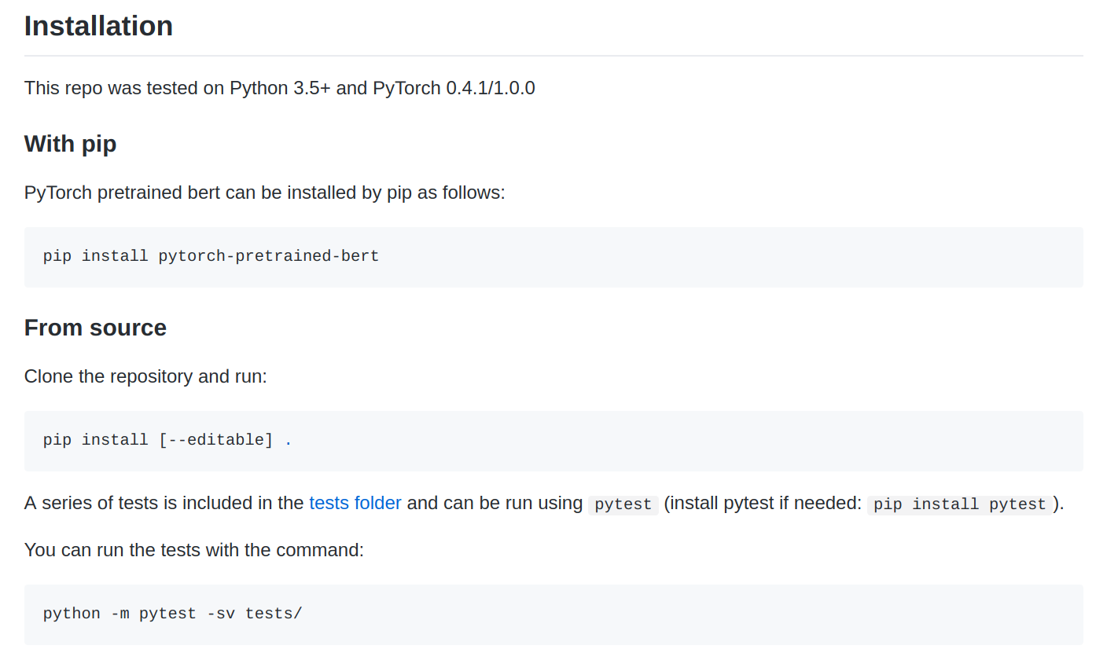
Provide Instructions
Notes:
and finally, you want to provide instructions

Slide 52
Reproducibility and AllenNLP
Notes:
ok, so since I'm here already, they said I can talk a little bit about the project I work on, and the design choices we've made to facilitate reproducibility

Slide 53
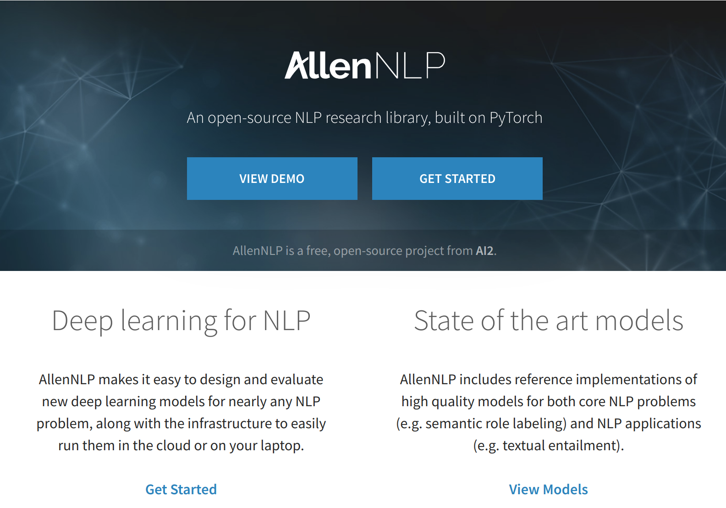
What is AllenNLP?
Notes:
so what is allennlp? it's an open source library built on PyTorch aimed at NLP researchers.

Slide 54
Programming to Higher-Level Abstractions
# models/crf_tagger.py
class CrfTagger(Model):
"""
The ``CrfTagger`` encodes a sequence of text with a ``Seq2SeqEncoder``,
then uses a Conditional Random Field model to predict a tag for each token in the sequence.
def __init__(self, vocab: Vocabulary,
text_field_embedder: TextFieldEmbedder,
encoder: Seq2SeqEncoder,
label_namespace: str = "labels",
feedforward: Optional[FeedForward] = None,
label_encoding: Optional[str] = None,
include_start_end_transitions: bool = True,
constrain_crf_decoding: bool = None,
calculate_span_f1: bool = None,
dropout: Optional[float] = None,
verbose_metrics: bool = False,
initializer: InitializerApplicator = InitializerApplicator(),
regularizer: Optional[RegularizerApplicator] = None) -> None:
super().__init__(vocab, regularizer)
...
Notes:
AllenNLP has a few distinctive features, the first is the inclusion of higher level abstractions as library primitives
what I mean is this: here's the class definition for a CrfTagger. you can see that it requires a vocabulary, some way of converting text into vectors, some way of encoding a sequence of vectors into a sequence of representations, and many other features

Slide 55
Declarative Configuration
"token_characters": {
"type": "character_encoding",
"embedding": {
"embedding_dim": 16
},
"encoder": {
"type": "cnn",
"embedding_dim": 16,
"num_filters": 128,
"ngram_filter_sizes": [3],
"conv_layer_activation": "relu"
}
}
}
},
"encoder": {
"type": "lstm",
"input_size": 1202,
"hidden_size": 200,
"num_layers": 2,
"dropout": 0.5,
"bidirectional": true
},
"regularizer": [
[
"scalar_parameters",
{
"type": "l2",
"alpha": 0.1
}
]
]
},
"model": {
"type": "crf_tagger",
"label_encoding": "BIOUL",
"dropout": 0.5,
"include_start_end_transitions": false,
"text_field_embedder": {
"token_embedders": {
"tokens": {
"type": "embedding",
"embedding_dim": 50,
"pretrained_file": "/path/to/glove.txt.gz",
"trainable": true
},
"elmo":{
"type": "elmo_token_embedder",
"options_file": "/path/to/elmo/options.json",
"weight_file": "/path/to/elmo/weights.hdf5",
"do_layer_norm": false,
"dropout": 0.0
},
Notes:
the library is designed so that you can full specify an instance of this model using JSON

Slide 56
Declarative Configuration
CrfTagger(
(text_field_embedder): BasicTextFieldEmbedder(
(token_embedder_token_characters): TokenCharactersEncoder(
(_embedding): TimeDistributed(
(_module): Embedding()
)
(_encoder): TimeDistributed(
(_module): PytorchSeq2VecWrapper(
(_module): GRU(25, 80, num_layers=2, batch_first=True, dropout=0.25, bidirectional=True)
)
)
)
(token_embedder_tokens): Embedding()
)
(encoder): PytorchSeq2SeqWrapper(
(_module): GRU(210, 300, num_layers=2, batch_first=True, dropout=0.5, bidirectional=True)
)
(tag_projection_layer): TimeDistributed(
(_module): Linear(in_features=600, out_features=4, bias=True)
)
(crf): ConditionalRandomField()
)
some voodoo involving inspect.getfullargspec and type annotations
JSON blob
CrfTagger.__init__

Slide 57
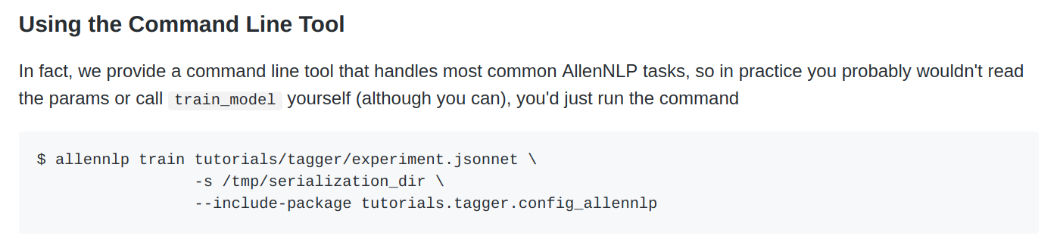
Command-Line Tools

Slide 58
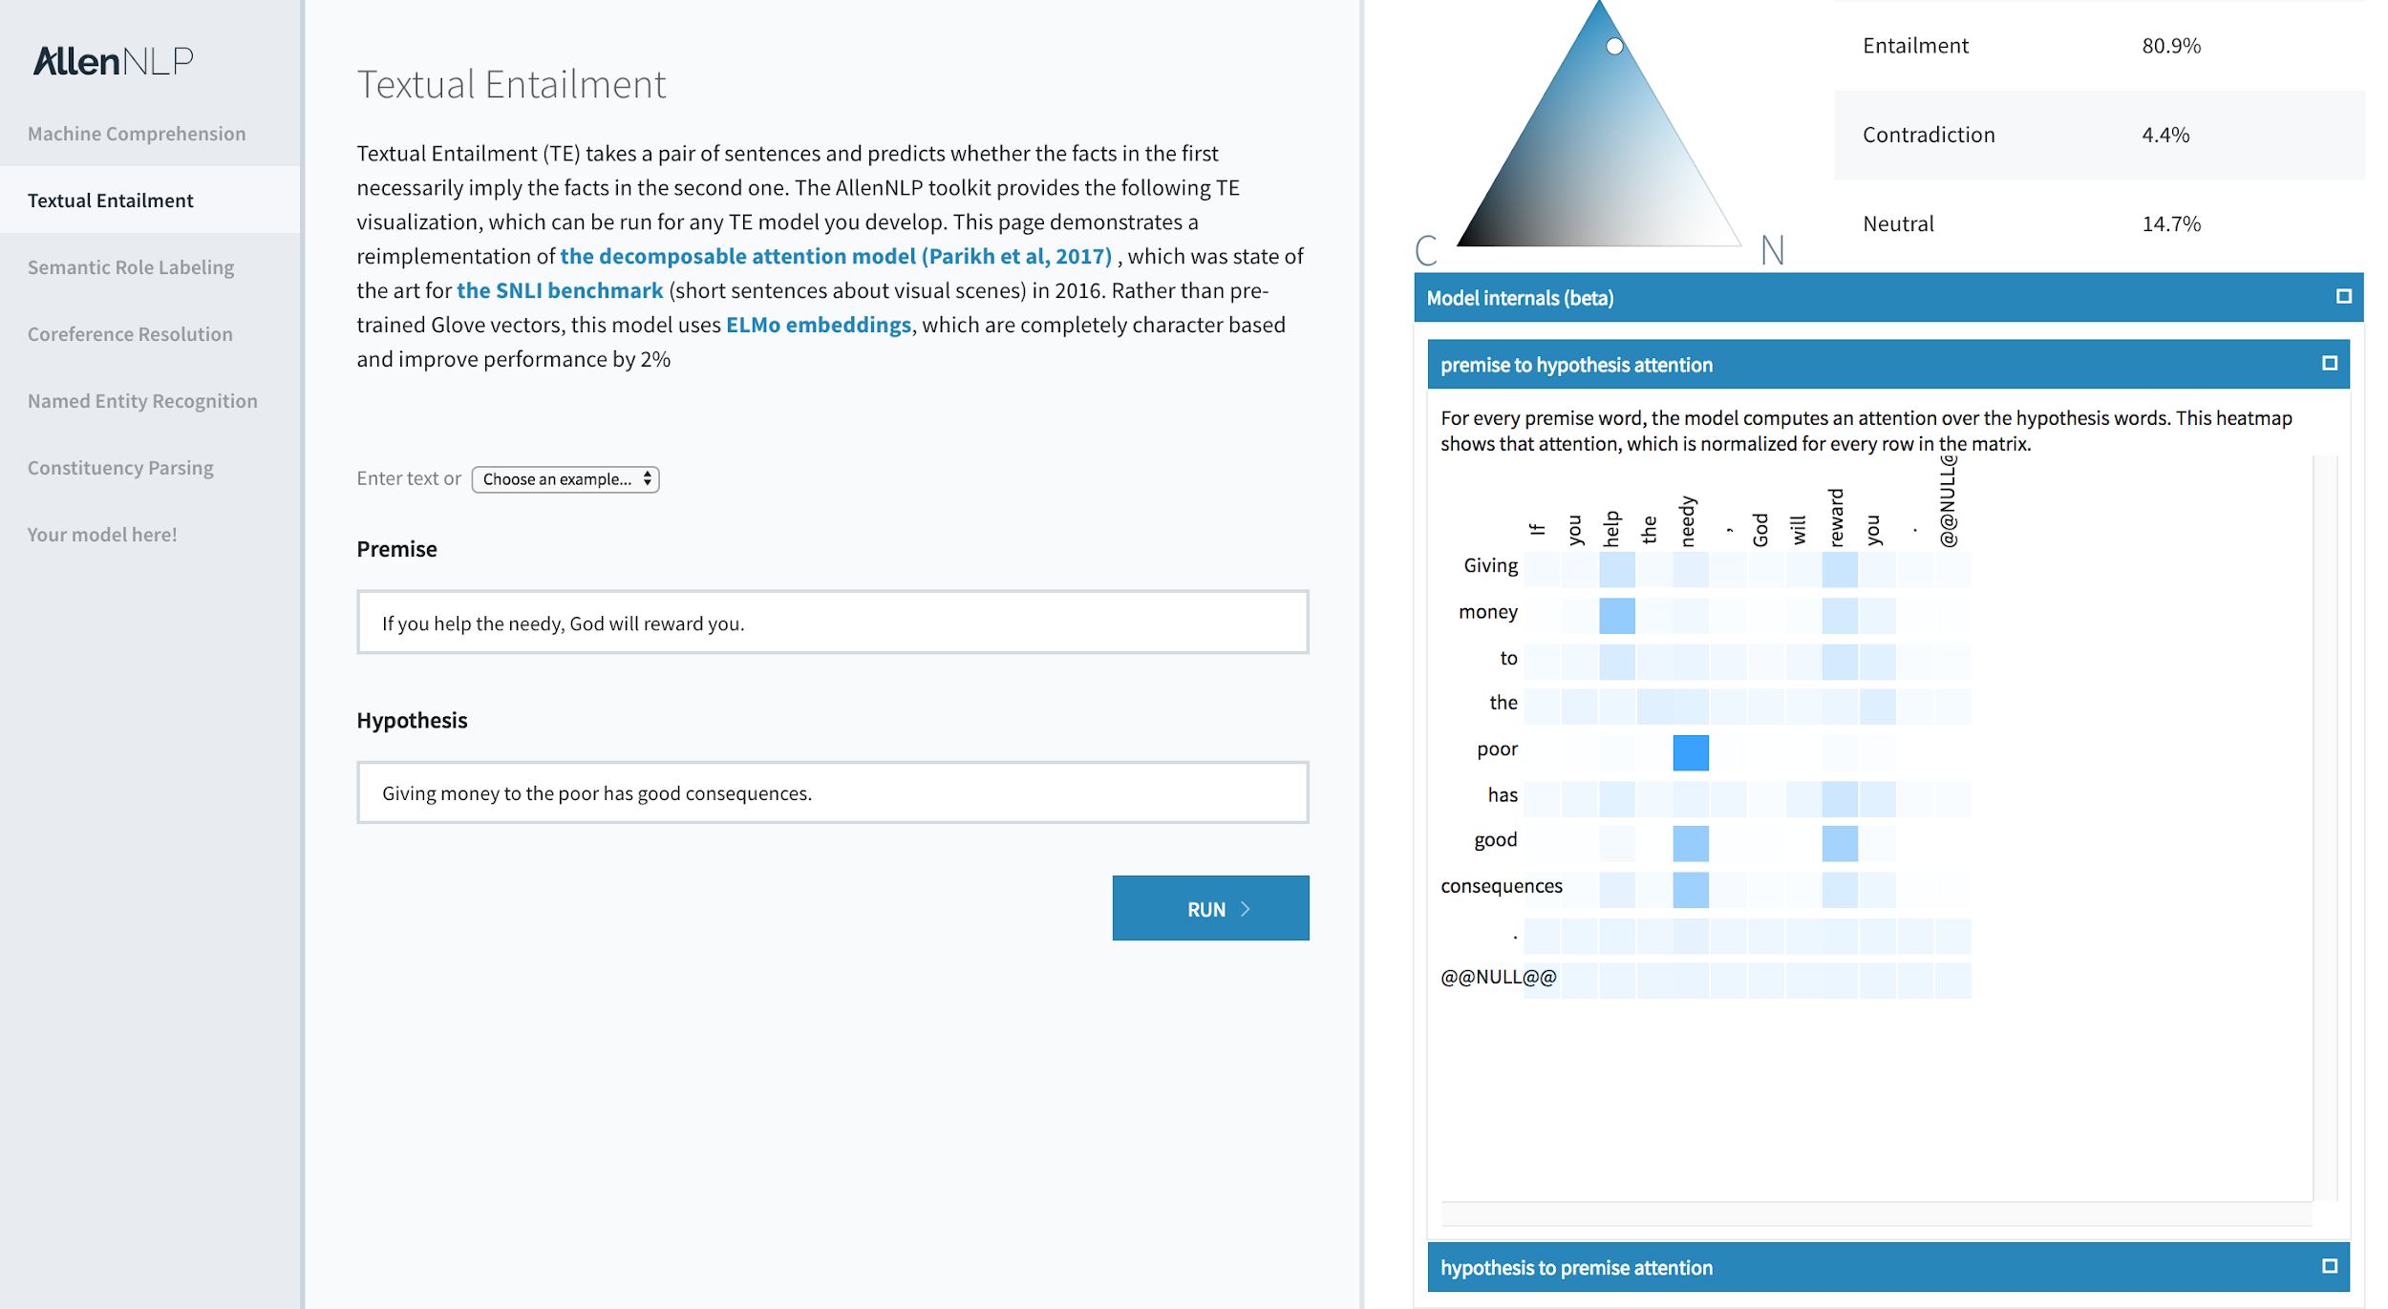
Interactive Demos and Visualization of Model Internals

Slide 59
Higher-Level NLP Abstractions as Library Primitives
Field + Instance (nice representation of examples)
question_field = TextField("What is the …", token_indexers)
instance = Instance({"question": question_field, "passage": passage_field)
Vocabulary (map word <-> index, label <-> index, etc)
TokenIndexer (map token -> [index1, ...., indexn]
could be one per word
could be one per character
could be one per wordpiece
TokenEmbedder (map indices -> embedding vectors)
Seq2VecEncoder (map [v1, …, vn] -> w)
Seq2SeqEncoder (map [v1, .., vn] -> [w1, …, wn])
...and many more

Slide 60
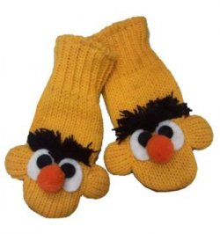
"I want to try using BERT vectors instead of GloVe vectors"

Slide 61
"Oh, great, now I'm going to make lots of changes to my code and maintain all these different versions so that my results are reproducible"
"I'll just make a new config file for the BERT version!"

Slide 62
"token_indexers": {
"tokens": {
"type": "single_id",
"lowercase_tokens": true
},
"token_characters": {
"type": "characters",
"min_padding_length": 3
}
}
"token_indexers": {
"bert": {
"type": "bert-pretrained",
"pretrained_model": std.extVar("BERT_VOCAB"),
"do_lowercase": false,
"use_starting_offsets": true
},
"token_characters": {
"type": "characters",
"min_padding_length": 3
}
}

Slide 63
"text_field_embedder": {
"token_embedders": {
"tokens": {
"type": "embedding",
"embedding_dim": 50,
"pretrained_file": "/path/to/glove.tar.gz",
"trainable": true
},
"token_characters": {
"type": "character_encoding",
"embedding": {
"embedding_dim": 16
},
"encoder": {
"type": "cnn",
"embedding_dim": 16,
"num_filters": 128,
"ngram_filter_sizes": [3],
"conv_layer_activation": "relu"
}
}
},
},
"text_field_embedder": {
"allow_unmatched_keys": true,
"embedder_to_indexer_map": {
"bert": ["bert", "bert-offsets"],
"token_characters": ["token_characters"],
},
"token_embedders": {
"bert": {
"type": "bert-pretrained",
"pretrained_model": std.extVar("BERT_WEIGHTS")
},
"token_characters": {
"type": "character_encoding",
"embedding": {
"embedding_dim": 16
},
"encoder": {
"type": "cnn",
"embedding_dim": 16,
"num_filters": 128,
"ngram_filter_sizes": [3],
"conv_layer_activation": "relu"
}
}
}
},

Slide 64
"Want to Reproduce My Results?"
create a virtual environment
clone my GitHub repo and pip install its dependencies
including a specific version of AllenNLP
which includes a specific version of PyTorch
each experiment has its own JSON configuration file
allennlp train specific_experiment.json -s /tmp/results

Slide 65
Reproducibility and Beaker

Slide 66

What is Beaker?
Kubernetes-based platform for rapid experimentation
Specify experiments as Docker containers + config.yaml
Request GPUs + Memory + etc
Upload or mount existing datasets
Track results
(Currently runs on GKE, working on a "runs on your machines" version)
Mostly internal-only for now (sorry)

Slide 67
What is Beaker?
beaker experiment run \ --name wordcount-moby \ --blueprint examples/wordcount \ --source examples/moby:/input \ --result-path /output

Slide 68
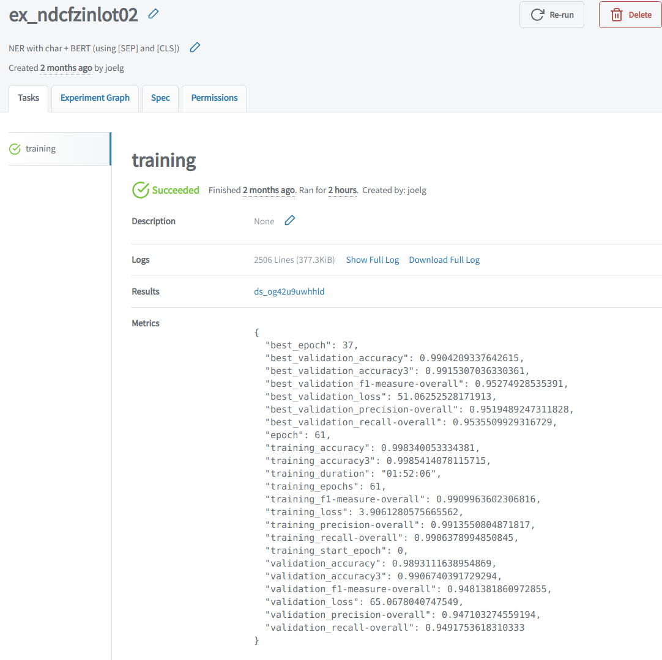
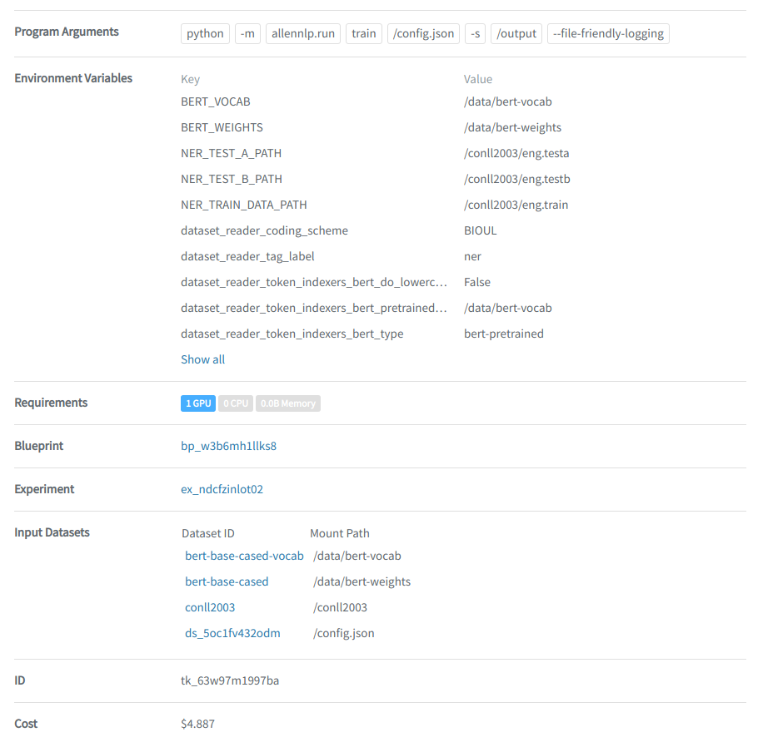
description
parameters
logs
docker image
metrics
datasets
cost

Slide 69
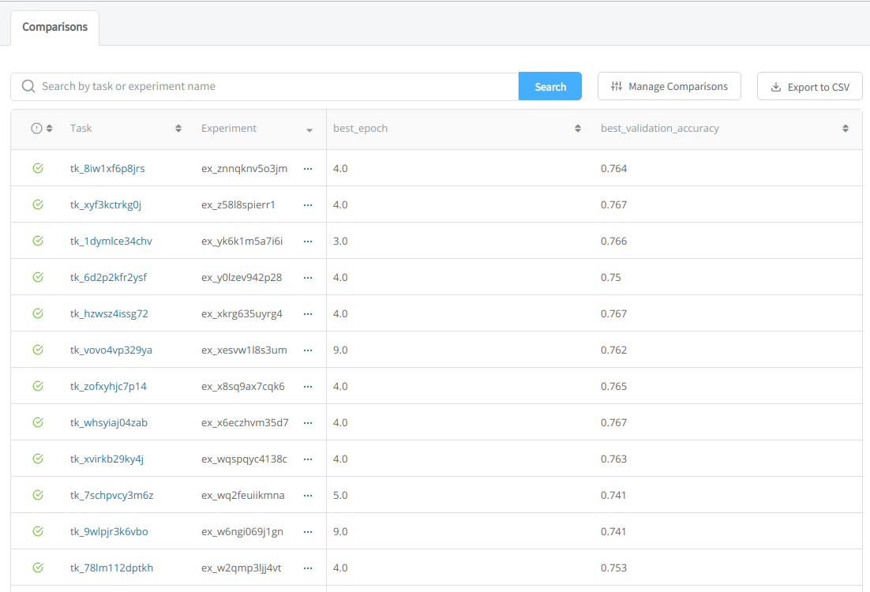
Organize Experiments Into Groups
ideally you'd give them more descriptive names, though

Slide 70
Beaker and Reproducibility
old code + new data => upload the dataset, reuse the blueprint
new code + old data => create the blueprint, point at existing dataset
want to see previous results?
inputs + logs + outputs stored "forever"
record of every experiment run + results
share with a link

Slide 71
To Sum Up
Reproducibility is important for more than the obvious reasons
Your choices of tools and processes make reproducibility easier or harder
There are several ways that notebooks make reproducibility harder
Search out tools that make reproducibility easier
Adopt processes that make reproducibility easier

Slide 72
A Few Related Presentations
I Don't Like Notebooks
The talk that launched a thousand arguments. Heavy on the memes.
Writing Code for NLP Research
EMNLP 2018 tutorial from me + Matt Gardner + Mark Neumann, goes much deeper into "what good research code looks like"
How Becoming Not a Data Scientist Made Me a Better Data Scientist
Explores some similar themes in the context of "why data scientists should care about software engineering best practices"

Slide 73

Any questions?
me: @joelgrus
AI2: allenai.org
AllenNLP: allennlp.org
Beaker*: beaker.org
will tweet out slides from
@joelgrus and @ai2_allennlp

